Slide 1
Analysis of Annoyance detecting algorithm

Slide 2
Problem
Low rate of users interaction with messages.

Slide 3

Our goals
Estimate/predict the number of messages seen & clicked based on the way we distribute messages
The number of total messages ‘shot’ from Zalo servers.
Improve the degree of interactions between user & messages
Detecting spam.
Increasing the seen & clicked rate.
The set of users chosen to be ‘shot’ by us and the number of according messages they receive.

Slide 4
Model for shooting messages
For each pair(user, OA), calculate the following indices
% messages seen (x₁)
% messages click (x₂)
The number of mess seen (x₃)
The number of mess clicked (x₄)
Other interactions of that user with that OA (x₅)
Score(user, OA) = f(x₁ ,x₂ ,x₃ ,x₄ ,x₅)

Slide 5
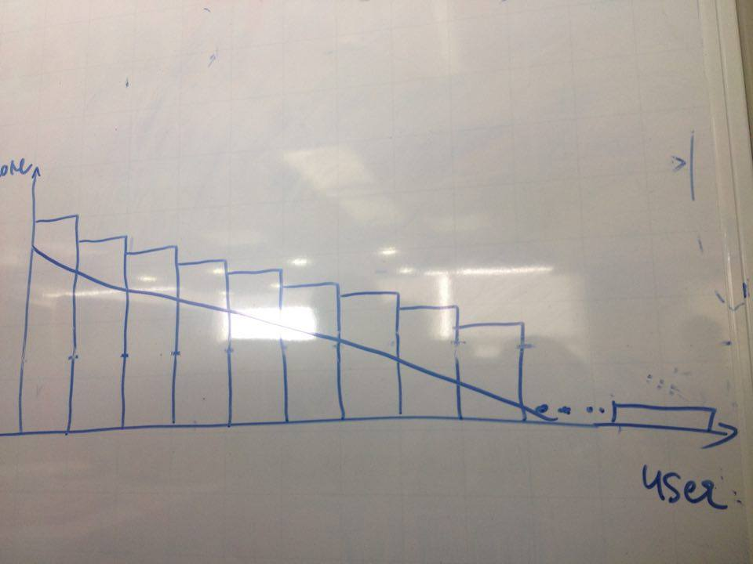
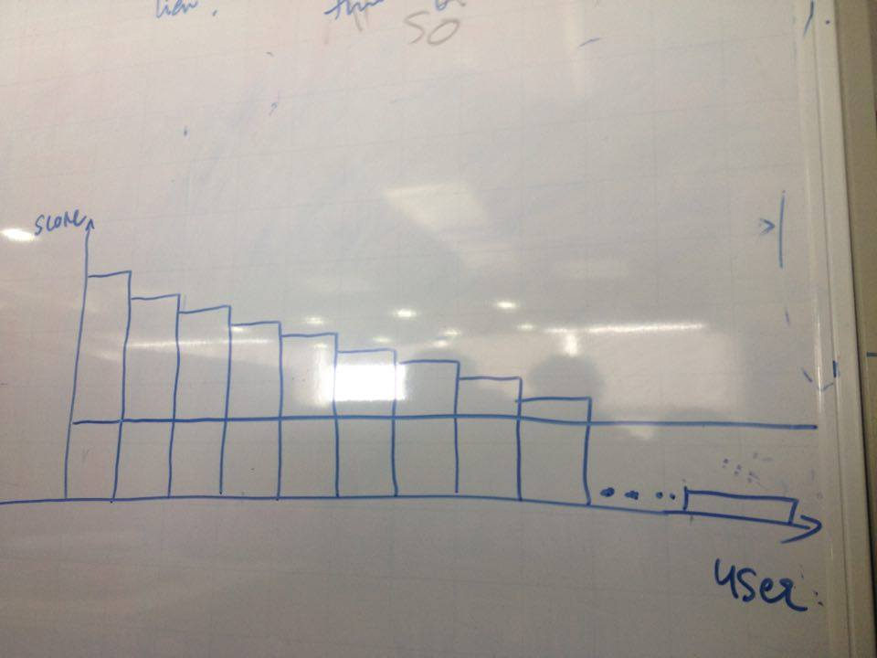
Model for shooting messages
Shooting strategy

Slide 6
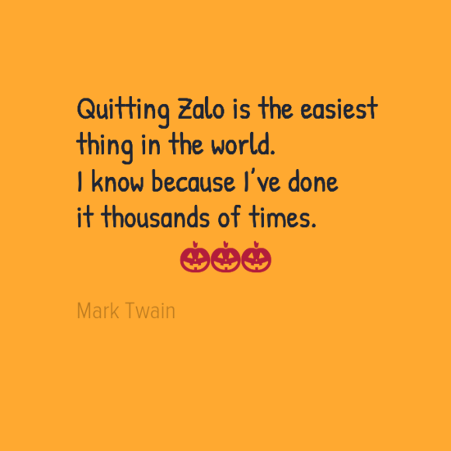

Basic assumptions for the model
Since people’s habits are NOT likely to change in a short time, User’s seen & clicked responses rate could be inferred from recent responses.
For a single user, if we increase the number of messages sent to him within a suitable range, the rate of messages being seen will be constant. (Need data to verify)

Slide 7
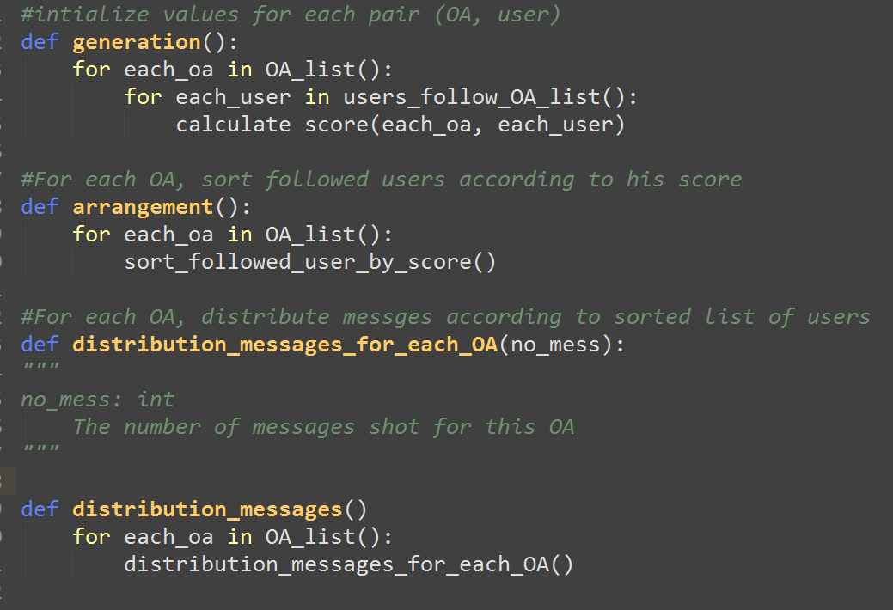
Algorithm - psudocode

